Slide 1
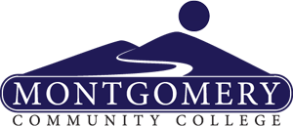
Montgomery Community College
Ribbon of Hope funds enabled Montgomery Community College’s GED2Degree program to offer its services to more citizens in Montgomery County. The program targets those without a high school diploma and provides personal coaching, mentoring, and career goal development using second-year Human Services students at Montgomery Community College as peer counselors. Prior to the GED2Degree program expansion, program staff conducted a focus group with community leaders who identified barriers to program participation, such as childcare and transportation needs, lack of information/communication skills, and financial barriers. Solutions that were identified included increasing recruitment efforts, marketing the program to other educational institutions, and providing classes in a variety of locations. The program served 425 students who were enrolled in the Basic Skills program; 70 students completed the Basic Skills program and 60 students enrolled in career training.

